Slide 1
Automatic Ticket Assignment System
FINAL report
Mentor: Dr. Sandeep Raghuwanshi
Vasundhara Madan
Vimal Pandey
Pradeep Kumar vp
Raghav Agarwal
Apurba Banerjee

Slide 2
Contents
Problem Statement
EDA(Exploratory Data Analytics)
Data Pre-processing
Modelling
Improve Model Performance
Model Selection and Hyper Tuning
Deployment
Comparison to Benchmark
Implications
Conclusions and Future Enhancements
Closing Reflections

Slide 3
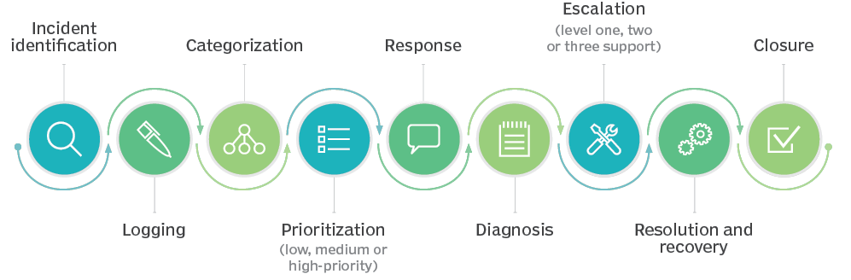
Problem Statement
In the support process, incoming incidents are analysed and assessed by organization’s support teams to fulfil the request. In many organizations, better allocation and effective usage of the valuable support resources will directly result in substantial cost savings.
However, successful closure is not the only thing which matters in customer satisfaction. SLA management of incident must be managed effectively. Generally, manually assigning the incident has some challenges as follows
Problem Statement:
❖ More resource usage and expenses.
❖ Human errors - Incidents get assigned to incorrect groups
❖ Delay in assigning the incidents
❖ More resolution times
❖ If an incident takes more time in analysis, other productive tasks get affected for the Service Desk
Objective:
❖ From the given problem description, we could see that the existing system is able to assign 75% of the tickets correctly.
❖ Build an AI-based classifier model to assign the tickets to right functional groups by analysing the given description with an accuracy of 60%-80%.

Slide 4
Data Findings
The dataset contains 8500 records with 4 attributes i.e. Short Description, Description, Caller and Assignment Group, which is the target column.
Each column is of data type object.
There are 7481 unique Short Description types for the given dataset. “Password Reset” is most frequently occurring Short Description.
There are 74 different Assignment groups. Almost 47% of the tickets are assigned to GRP_0 and 53% of the tickets are assigned to the remaining 73 assignment groups.
Imbalanced class data
There are 9 records with missing values- 8 records with missing/NaN Short description and 1 record with missing/NaN Description.
There are 83 records with duplicate values.
The data belongs to 29 different languages. Almost 84% of the records belong to English language.

Slide 5

Exploratory Data Analysis(EDA)
It is Data Analysis Process where a number of techniques are used to better understand the dataset being used.
It helps clean up a dataset.
It gives you a better understanding of the variables and the relationships between them.
Created custom columns to study and better understand the data. Following columns were created:
Created a custom column “Full Description” by concatenating “Short description” and “Description” column.
Added few custom columns like Char_len and Word_len to study the no. of characters and no. of words in Full Description column for every record.
Added a ‘language’ column to study to detect the language type for every record
Added a column ‘STOPWORDS’ to study the stop words in Full Description column of every record.
The min length of Full Description is 3 where as the max length for Full Description is 13104.

Slide 6
Data Pre-processing
Drop Missing Values
Drop Duplicates
Remove HTML Tags
Remove Accented Text
Remove Punctuation
Remove Special Characters
Lemmatization

Slide 7
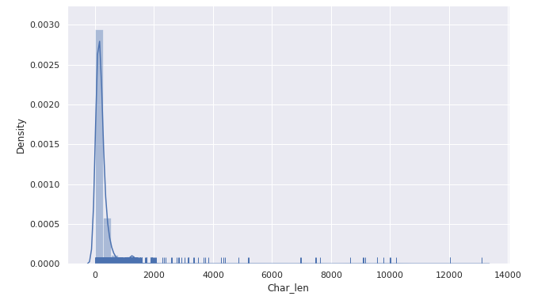
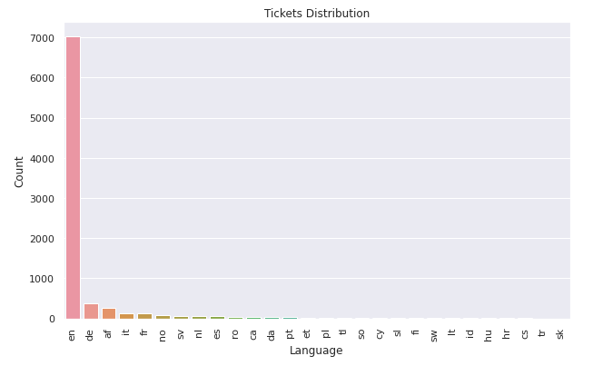

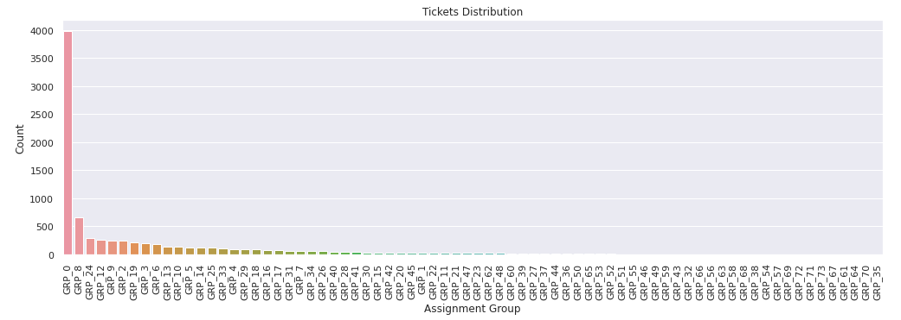
Visual Analysis

Slide 8
Modelling
We have used ML based classification models as well as AI based classification models to assign tickets to functional groups.
ML Based Classification models with TF-IDF
Full Description column i.e. Short description + Description has been vectorised to TF-IDF using TfidfVectorizer using unigrams
Select top 5000 features using Chi-squared test
Different ML based classifications models were used and following accuracies were found
Note: Random Forest Classifier model is overfitting
Model Type | Training Accuracy | Test Accuracy
Naïve Bayes Classifier | 57.05 | 57.53
SVM Classifier | 66.48 | 64.26
Decision Tree Classifier | 63.07 | 60.95
Random Forest Classifier | 95.06 | 64.1

Slide 9
MODELLING
ML Based Classifier with Glove Embeddings
Vectorised Full Description column using Glove embedding with embedding size as 300
Label encoding of the target variable i.e. Assignment group
Different ML based classification models were used and following accuracies were found
Note: Using glove embeddings, all the models are overfitting
Model Type | Training Accuracy | Test Accuracy
SVM Classifier | 89.25 | 66.59
Decision Tree Classifier | 62.27 | 55.87
Random Forest Classifier | 95.16 | 61.43

Slide 10
MODELLING
AI Based Classification Models
Vectorised Full Description column using Glove embedding with embedding size as 300
Label encoding of the target variable i.e. Assignment group
Different AI based classification models were used and following accuracies were found
OBSERVATIONS:
All the AI based model are overfitting.
Hyper tuning of the models in required to further improve the performance all the while ensuring that the model doesn’t overfit
Model Type | Training Accuracy | Test Accuracy
Simple Dense NN | 51.76 | 49.21
Convolutional NN | 58.31 | 57.77
RNN Based LSTM | 59.23 | 56.81

Slide 11
AI Based Models: Architectural Details
Simple Dense NN
Convolutional NN
LSTM
Input Dense Layer wit 512 neurons/nodes and ‘he_normal’ initializer
3 hidden layers with 512 neurons in each layer, relu activation
Every hidden layer is followed by Batch Normalization layer and Dropout layer with dropout ratio of 0.3
Output layer with activation function softmax
Input layer with max length as 200
Embedding layer with emb. size as 300
5 layers of (Conv1D+MaxPool1D) with kernel size in each Conv1D layer as 2,3,4,5,6 and nodes=128, activation: relu
2 layers of (Conv1D+dropout+Batch Norm+MaxPool1D) with 128 nodes in each Conv1D,kernel size 5,activation: relu, dropout ratio 0.5,
Next flatten followed by dense layer of 1024 and 512 resp.
Output layer with 74 nodes and softmax activation
Embedding layer with max length: 200, dense emb size 300
Bidirectional LSTM Layer with 256 units
3 units of (Dense + Activation + Dropout) layers
Every dense layer has 512 nodes
Activation function used is ReLu
Dropout layer with a dropout ratio of 0.5 is used
Output dense layer with 74 units along with softmax activation is used

Slide 12
How to improve model performance
To improve model performance, we will try out following:
Try glove embeddings with size 100, 200 and 300
Try to learn embeddings instead of using glove embeddings
Try bigram and trigrams also with TF-IDF
For LSTM model, try unidirectional as well as bidirectional LSTM
For LSTM model, try different no. of LSTM layers with 64, 128 and 256 LSTM units in each layer
Try different optimizers like Adam, RMSProp by varying the learning rate
Try different activation functions like ReLu, P-ReLu, Leaky ReLU etc
Try working with data belonging to top 5 and top 10 groups to address the class imbalance issue

Slide 13
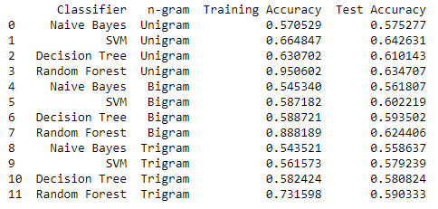
Model Selection and Hyper Tuning
ML Based Classifier:
Approach 1: TF-IDF with Bi-grams
Here we analyzed how the performance of the above models changed when we used bi-gram TF-IDF. Following accuracies were observed.
Approach 2: TF-IDF with Tri-grams
Here we analyzed how the performance of the above models changed when we used tri-gram TF-IDF. Following accuracies were observed:
Conclusion
Comparing the ML based classifier accuracies w.r.t TF-IDF using uni-gram, bi-gram and tri-gram, it can be seen that SVM model performs best with TF-IDF using uni-gram.

Slide 14
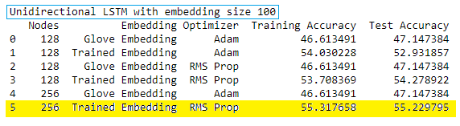
Unidirectional LSTM with embedding size 100
Architectural Details:
Embedding layer of dense embedding size:100
2 layers of unidirectional LSTM with 128/256 nodes in each layer
Dense layer with 128 neurons, activation: relu
Dropout layer with dropout ratio 0.5
Dense layer with 128 neurons, activation: relu
Dropout layer with dropout ratio 0.5
Dense layer with 64 neurons, activation: relu
Dropout layer with dropout ratio 0.2
Output layer with 74 neurons and softmax activation function
LSTM Units in LSTM Layer:
128, 256
Optimizers used:
Adam and RMS Prop
Embedding used:
Glove Embeddings and Trained Embeddings
Model Selection and Hyper Tuning

Slide 15
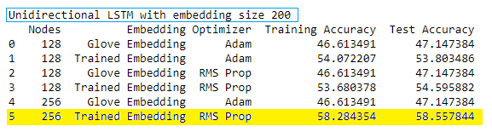
Unidirectional LSTM with embedding size 200
Architectural Details:
Embedding layer of dense embedding size:200
-2 layers of unidirectional LSTM with 128/256 nodes in each layer
-Dense layer with 128 neurons, activation: relu
-Dropout layer with dropout ratio 0.5
-Dense layer with 128 neurons, activation: relu
-Dropout layer with dropout ratio 0.5
-Dense layer with 64 neurons, activation: relu
-Dropout layer with dropout ratio 0.2
-Output layer with 74 neurons and softmax activation function
LSTM Units in LSTM Layer:
128, 256
Optimizers used:
Adam and RMS Prop
Embedding used:
Glove Embeddings and Trained Embeddings
Model Selection and Hyper Tuning

Slide 16
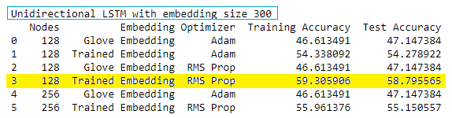
Unidirectional LSTM with embedding size 300
Architectural Details:
Embedding layer of dense embedding size:300
2 layers of unidirectional LSTM with 128/256 nodes in each layer
Dense layer with 128 neurons, activation: relu
Dropout layer with dropout ratio 0.5
Dense layer with 128 neurons, activation: relu
Dropout layer with dropout ratio 0.5
Dense layer with 64 neurons, activation: relu
Dropout layer with dropout ratio 0.2
Output layer with 74 neurons and softmax activation function
LSTM Units in LSTM Layer:
128, 256
Optimizers used:
Adam and RMS Prop
Embedding used:
Glove Embeddings and Trained Embeddings
Model Selection and Hyper Tuning

Slide 17
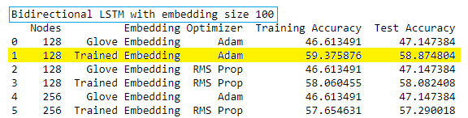
Bidirectional LSTM with embedding size 100
Architectural Details:
Embedding layer of dense embedding size:100
2 layers of bidirectional LSTM with 128/256 nodes in each layer
Dense layer with 128 neurons, activation: P-Relu
Dropout layer with dropout ratio 0.5
Dense layer with 64 neurons, activation: P-Relu
Dropout layer with dropout ratio 0.2
Output layer with 74 neurons and softmax activation function
LSTM Units in LSTM Layer:
128, 256
Optimizers used:
Adam and RMS Prop
Embedding used:
Glove Embeddings and Trained Embeddings
Model Selection and Hyper Tuning

Slide 18
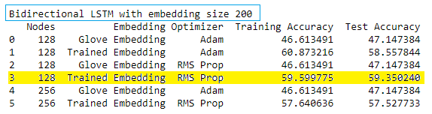
Bidirectional LSTM with embedding size 200
Architectural Details:
-Embedding layer of dense embedding size:200
-2 layers of bidirectional LSTM with 128/256 nodes in each layer
-Dense layer with 128 neurons, activation: P-Relu
-Dropout layer with dropout ratio 0.5
-Dense layer with 64 neurons, activation: P-Relu
-Dropout layer with dropout ratio 0.2
-Output layer with 74 neurons and softmax activation function
LSTM Units in LSTM Layer:
128, 256
Optimizers used:
Adam and RMS Prop
Embedding used:
Glove Embeddings and Trained Embeddings
Model Selection and Hyper Tuning

Slide 19
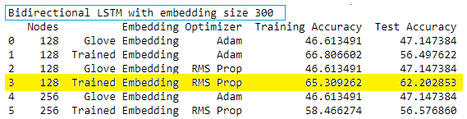
Bidirectional LSTM with embedding size 300
Architectural Details:
-Embedding layer of dense embedding size:300
-2 layers of bidirectional LSTM with 128/256 nodes in each layer
-Dense layer with 128 neurons, activation: P-Relu
-Dropout layer with dropout ratio 0.5
-Dense layer with 64 neurons, activation: P-Relu
-Dropout layer with dropout ratio 0.2
-Output layer with 74 neurons and softmax activation function
LSTM Units in LSTM Layer:
128, 256
Optimizers used:
Adam and RMS Prop
Embedding used:
Glove Embeddings and Trained Embeddings
Model Selection and Hyper Tuning

Slide 20

Simple LSTM Model
Architectural Details:
Embedding layer with trained embeddings of size 100
Unidirectional LSTM Layer with 128 nodes
Dropout ratio: 0.3 and Recurrent Dropout:0.2
Dense layer with 64 units and relu activation function
Output layer with 74 units and softmax activation function
Optimizers used:
Adam with learning rate 0.001
Embedding used:
Trained Embeddings size 100
Observations:
Trained Embedding seems to give better model accuracy as compared to Glove Embeddings
128 LSTM units in LSTM layer give better accuracy
In each case, we observed that RMS Prop optimizer gave a better accuracy as compared to Adam optimizer
Model Selection and Hyper Tuning

Slide 21
Final AI Based Model Selected
Bidirectional LSTM with trained embeddings of size 300 with RMS Prop Optimizer
Accuracy: 62.2% which is an improvement compared to the LSTM model we started out with i.e. 56.81%.
Saved the best performing model to ‘best_model.h5’ file and the corresponding weights to ‘best_weights.h5’ for future reference.
After performing hyper-tuning the LSTM model, we were able to improve the accuracy by around 5.39%

Slide 22
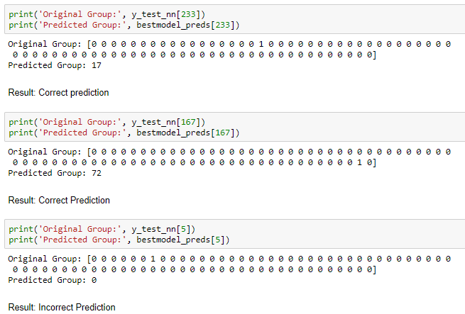
Predictions using best model

Slide 23

Top 10 groups
Since the dataset provided is highly imbalanced. Almost 47% of the tickets are assigned to GRP_0 and the remaining 53% tickets were distributed or assigned to remaining 73 functional groups. This imbalanced class data causes the model to perform with only 60% accuracy. Thus, we decided to have subset of the data to include records that only belong to top 10 groups.
Train-Test Split for Top 10 groups
Dataset was split in 0.85:0.15 ratio to get training and test data
Total no. of records: 6349
Total no. of training records: 5396
Total no. of test records: 953
After fitting and compiling the above model, following accuracy was observed:
Accuracy: 74.29%

Slide 24

Top 5 groups
We tried to further filter the original dataset to get records belonging to top 5 functional groups and see it the accuracy was further improved or not.
Train-Test Split for Top 5 groups
Dataset was split in 0.85:0.15 ratio to get training and test data
Total no. of records: 5365
Total no. of training records: 4560
Total no. of test records: 805
After fitting and compiling the above model, following accuracy was observed:
Accuracy: 89.57%

Slide 25
Deployment
Pickling
We used python’s pickle module to serialize the best model object and created a pickle file i.e. “auto_ticket_assignment.pkl”.
Flask- RESTful
Next, we used Flask to create a RESTful API which loads the best fit model object from the pickle file to predict the group.
Deploying Flask API on IIS
Installed the CGI feature
Installed wfastcgi package on the python environment.
Enabled wfastcgi and configured Fast CGI Settings in IIS
Setting up the flask API on IIS.
Setting up the handler mappings for the Flask API.
Testing Flask API through Postman
We used Postman application to test Flask API which predicts the group. The API takes ticket description as the input and gives group as the output.

Slide 26
Comparison to benchmark
We started out with RNN Based LSTM Model with an accuracy of 56.81% which was our benchmark. However, after employing hyper tuning techniques and varying the model architecture, optimizer etc. we were able to achieve an accuracy of 62.2%
We were able to improve the accuracy on the benchmark by 5.39%.
We hoped to increase the model accuracy up to 80% with the original dataset. However, since the original dataset was highly imbalanced, we could only improve the accuracy to 62.2% and 64.26% with AI-Based Classifier and ML-Based Classifier respectively.
To prove our hypothesis, we later tried to create 2 different datasets - one with top 10 groups and other with top 5 groups. We tried to fit and compile the model created for original dataset on top 10 and top 5 groups dataset and achieved an accuracy of ~75% and ~90%. This proves our assumption that the reason for low accuracy on original dataset is because of data imbalance.

Slide 27
Implications
With manual ticket assignment in Incident Management Process, 1 FTE spends around 15 mins on SOP review for each incident before assigning it to a functional group.
Guided by AI-ML techniques, we have built a classifier that allows organizations to automatically assign tickets to correct group instantaneously.
By using this AI-ML based automated ticket assignment mechanism, organizations can achieve following:
FTE Cost Saving
Time saving
Better support staff allocation
Improve Customer Service experience by reducing the no. of queued incident tickets
Better SLA Management
Overall improved turnaround time for a request/incident

Slide 28
Conclusion and Future Enhancements
The original dataset presented to us had a total of 74 functional groups to which tickets were assigned. However, ~47% of the tickets belonged to just one group i.e. GRP_0. 53% tickets belonged to remaining 73 groups. This shows data presented to us was highly imbalanced.
For many functional groups in the dataset, there was very little training data for the models.
As a future enhancement, we can use text generative model to get more set of training examples which would potentially lead to better model performance.
The original dataset presented to us is multilingual. The embeddings used in this project are English word embeddings. We can even use non-English pre-trained word embeddings.
As a future enhancement, we can use some other multilingual deep learning-based models like mBert.

Slide 29
Closing Reflections
Pre-Processing, Data Visualization and EDA
Model Building
Test the model and Fine Tuning
We learnt how to deploy the model on IIS as Flask RESTful API
Project Closure
All the project artifacts are available at: Vimal2308/NLP-Capstone-Project: NLP Capstone Project (github.com)

Slide 30
THANK YOU

